Slide 1

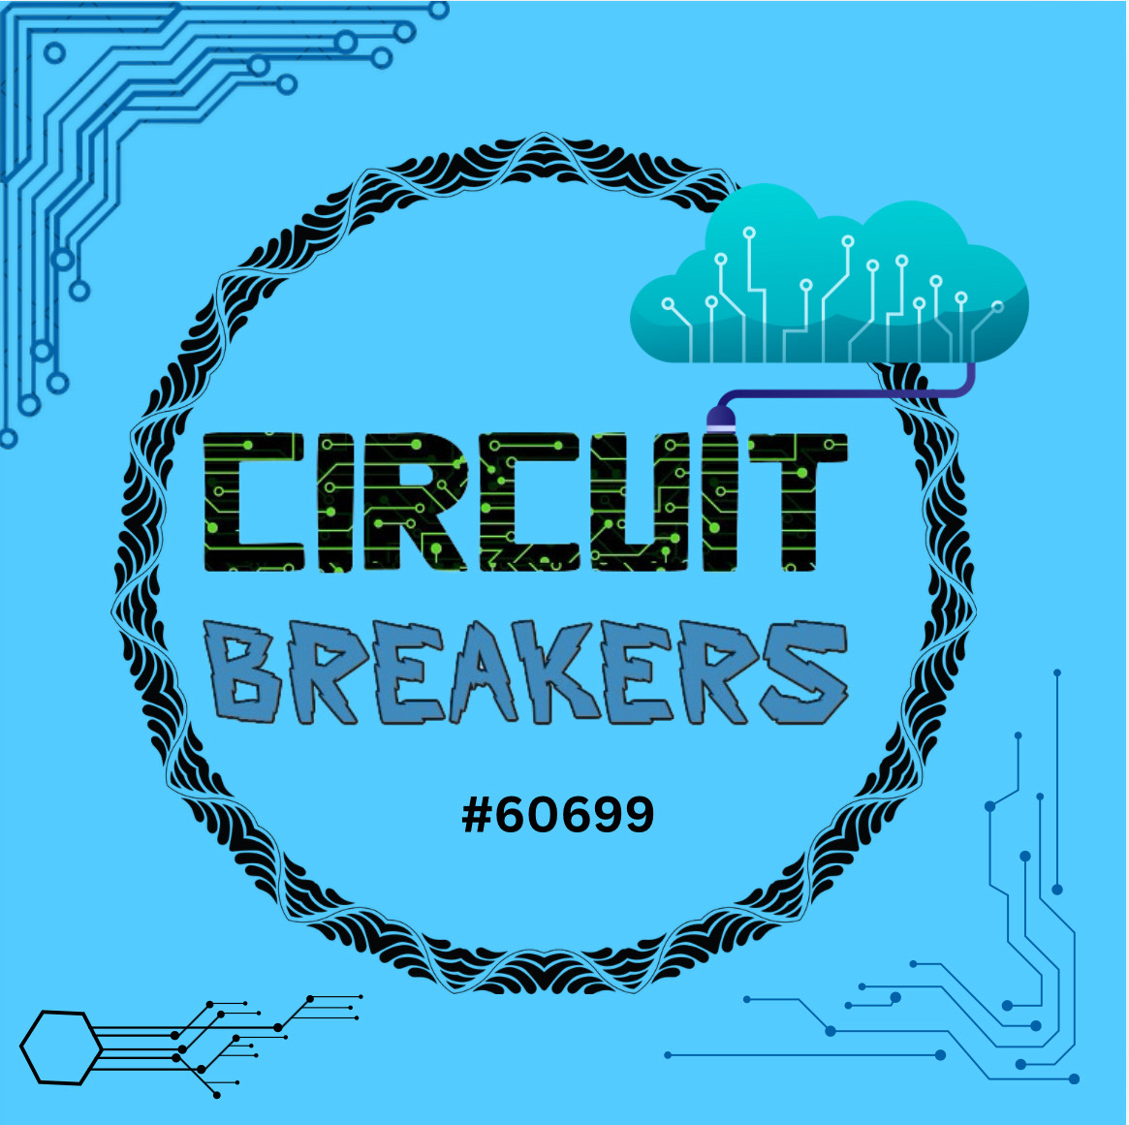
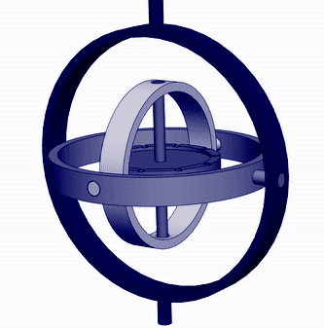
Navigation Buoy
By Circuit Breakers Team #60699

Slide 2
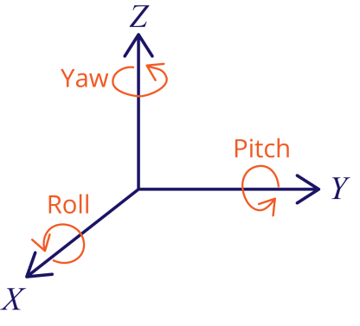
Gyroscope in submarines
This device consisting of a wheel or disk mounted so that it can spin rapidly about an axis which is itself free to alter in direction. The orientation of the axis is not affected by tilting of the mounting, so gyroscopes can be used to provide stability or maintain a reference direction in navigation systems, automatic pilots, and stabilizers.
Working:
Components: Yaw, Pitch, and Roll.
Keeps an object upright.
Provides navigation and stability for submarines, especially underwater where GPS signals are unavailable

Slide 3
PROBLEM STATEMENT
Gyroscopes in submarines face an issue called drift, this is when the gyroscopes readings become less accurate over time. This leads to inaccurate data which causes problems for submarines to stay on track. Because of this submarines have to surface regularly to recalibrate. But for tactical submarines,this can be a issue for stealth.
Reference Sites -
https://apps.dtic.mil/sti/tr/pdf/AD0499621.gpdf
Ref - Page #43 on digital book, printed page #32 paragraph 3
https://discover.dtic.mil/

Slide 4
INS (Inertial Navigation System ) Working
Gyroscopes lose speed and accuracy over time due to
  Mechanical Wear
  Temperature Changes.
INS only works accurately for small amounts of periods.
Overtime it provides long-term mis accuracies causing wrong directions.
INS systems suffer from drift, cumulative errors, and require complex maintenance.

Slide 5
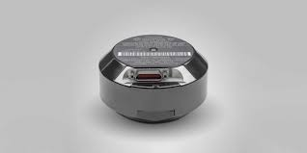
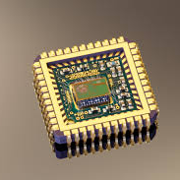
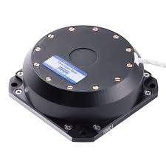
Existing solutions & Con’s
Ring Laser Gyroscopes (RLGs):
  Use laser beams for rotational motion detection
  Expensive, complex, and power-hungry
Fiber Optic Gyroscopes (FOGs):
  Use light in optical fibers for accuracy
  Require delicate installation, raising costs
Microelectromechanical Systems(MEMS) Gyroscopes:
  Compact, cost-effective
  Lower accuracy, higher drift rates
  Sensitive to vibrations and temperature fluctuations
Meaning of Dead Reckoning:
  Is based on speed and direction
  Useful without GPS, but errors accumulate over time
  Unreliable for long missions without updates
RLG
FOG
MEMS

Slide 6
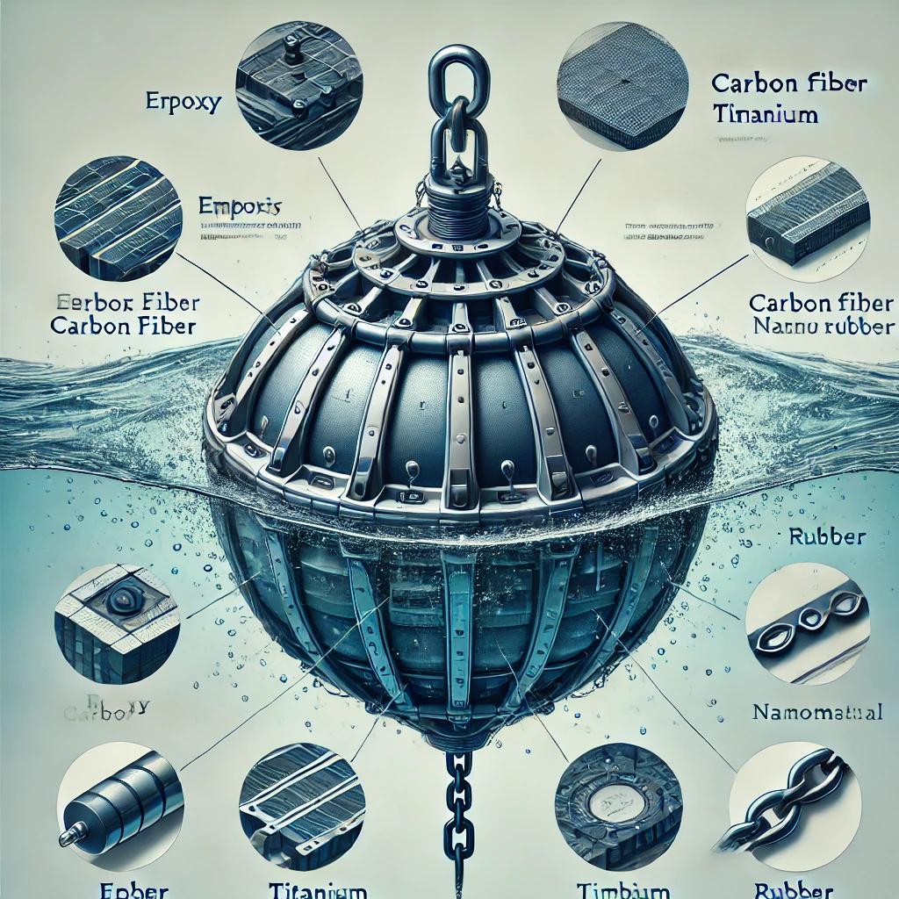
Solution - Navigation Buoy
Image Courtesy AI
Solution: A sturdy & reliable Buoy that can surface on its own without submarine being in diving position to collect data, access GPS, or communicate.
Pro’s
Helping keep ocean clean by making Buoy retrievable.
Full proof solution for existing/older submarine.
It can access different data based on the submarines needs.
If one of the sensors gets harmed we can easily replace it without replacing the entire buoy.
Withstand the pressure of midnight zone by use of Specialized Polyurethane Foam (SPF).
Undetected due to Phase Change Materials (PCM) by Thermal detectors.
To have an additional measure we can use reinforced aerogel composites.

Slide 7
Bill of Materials
Step 1 - Buoy Casing
Tactical Buoy | Prototype Buoy
Nanomaterials - used to smooth the surface of the buoy to minimize capillary wave | Primer - smooths the surface of the buoy to apply epoxy
Kevlar - strengthens the tether | Rope - holds the buoy in place
Epoxy - helps keep different materials stuck together | Stixall + Epoxy - helps keep different materials stuck together (same thing)
Titanium - helps protect the hardware | PETG - helps protect the hardware + keep the heat at a minimum

Slide 8
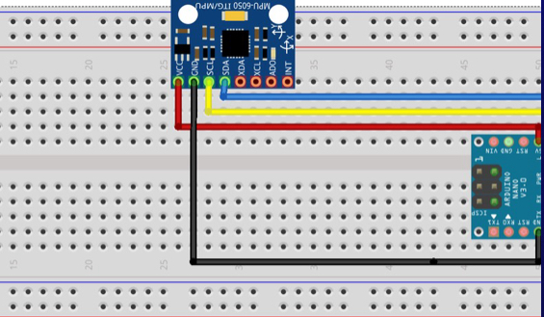
Bill of Materials - Prototype
Step 2 - Making Wave and Water Temperature Measurements
GY-521 = Used for measuring air temperature, wave height, and wave energy. It also has magnetometer which has compass which enables specific location and direction.
Arduino = Electric board used for fixing sensors in our project
Water temperature sensor

Slide 9
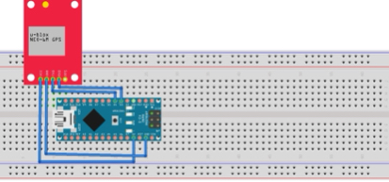
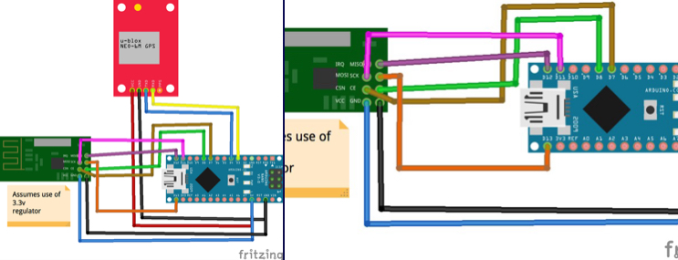
Bill of Materials - Prototype
Step 3 - Getting Gps Data Via Radio Signals
2x Arduino - helps connect all components together
Raspberry Pi - acts as a computer and runs code to use data from sensors to give information about the buoy and its surroundings
Radio module - communicates data to the outside world
SD card - records and stores data incase the data cannot be transmitted to the outside
Gps module - used to get real time gps data on the computer
SD card

Slide 10
Bill of Materials - Prototype
Step 4- Powering the Buoy
Buck Booster - Increases power and voltage of the battery
Transistor - powers Raspberry Pi
16850 Battery - to power the buoy
Charge Controller - To control the output of the battery
Power monitoring module - To monitor the buoy battery’s voltage and current usage
Real time clock module - This is used to control power to the Raspberry Pi. An alarm is set based on the battery voltage. When the alarm is triggered, it makes a very low sound, which turns on the transistor, which gives power to the raspberry pi. This is a cycle. After the power is given, the alarm makes a high sound and the transistor turns off.
Ptc channel transistor - This transistor gives power to the Raspberry Pi through the alarm.
Blocking Diodes - prevent reverse current into the battery

Slide 11
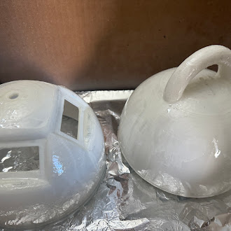
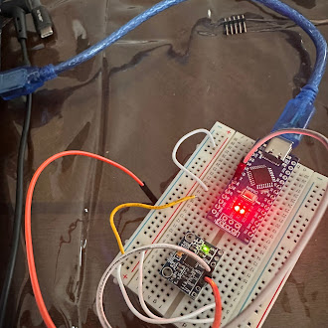
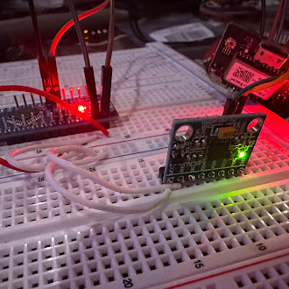
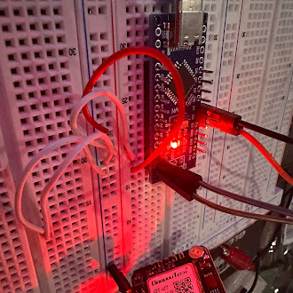
Prototype Procedure

Slide 12
Work Cited
iXblue
https://www.ixblue.com/knowledge/what-is-fiber-optic-gyroscope-technology/
Advanced Navigation
https://www.advancednavigation.com/
Smart buoy
https://techpartnerships.noaa.gov/blue-ocean-gear-smart-buoy/
Instructables
https://www.instructables.com/Smart-Buoy/

Slide 13
THANK YOU!!

